Slide 1

The Price of Policing: Uncovering Local Economic Divides in Stop and Search
Kofi Barton-Byfield
23475742

Slide 2

Background
Definition of Stop & Search
A Policing Policy that allows police to stop, detain and search individuals if they have suspicion the individual committed a crime.
an officer has reasonable grounds for suspicion that a person is in possession of a stolen or prohibited item, or controlled drugs, or if a person is in an area where serious violence is anticipated.
There are several powers of search, but majority of powers used are included in:
section 1, Police and Criminal Evidence Act 1984
section 23, Misuse of Drugs Act 1971
section 60, Criminal Justice and Public Order Act 1994

Slide 3

Motivation
Stop and Search (S&S) is one of the UK’s most controversial police powers
Low conviction rates raise questions about its effectiveness
Evidence of ethnic disproportionality fuels public distrust
Research is largely London-focused and race-oriented
This study shifts focus to economic inequality
and regional context
Notes:
S&S functions as a tool for maintaining social order rather than solely for crime deterrence.

Slide 4
Research Question
“To what extent do the spatial patterns of stop and search in Merseyside and Greater London, reflecting their differing social compositions, correlate with localised economic disparities at the LSOA level?”
AIM: to assess whether economic inequality plays a distinct role in stop and search deployment across two very different urban contexts.
How this economic inequality varies in different cultural make-ups

Slide 5
Hypotheses
Hypothesis 1: S&S rates will correlate with higher income deprivation at the LSOA level.
Hypothesis 2: The strength of this correlation will vary significantly between London and Merseyside.
Hypothesis 3: The interaction between income deprivation and ethnic diversity will show that economically deprived, ethnically diverse areas face the highest levels of S&S activity.

Slide 6
Data Sources
Stop & Search data (2022)
Social
Make-up
Income Deprivation
Mean house prices

Slide 7

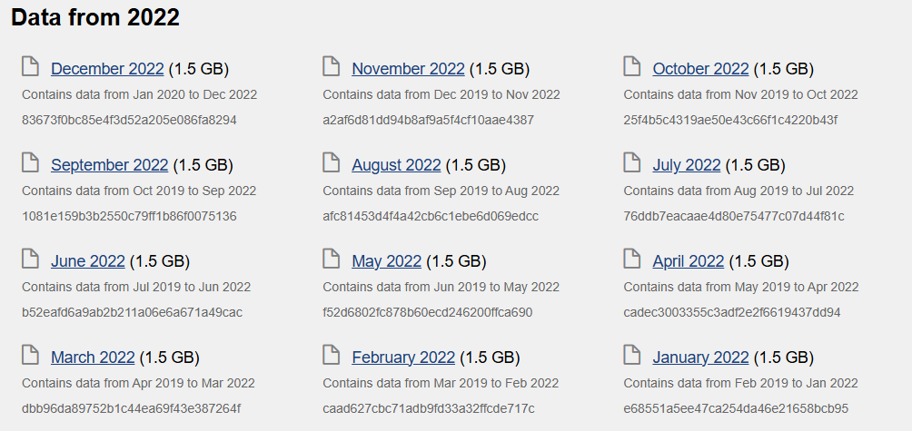
Data Sources – UK Police
The analysis uses 2022 stop and search data from the UK Police with the UK Police API to explore spatial patterns and disparities across LSOAs in London and Merseyside.
Stop & Search
Crime

Slide 8
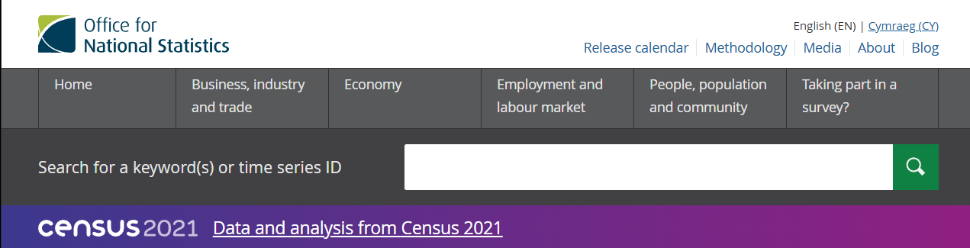
Data Sources – Other Variables
The other descriptive variables are collected from the 2021 ONS Census, which provides detailed demographic and socio-economic data at the local authority level, including information on population characteristics, ethnicity, housing, and employment status, among other factors.
Notes:
House price
Ethnic makeup

Slide 9
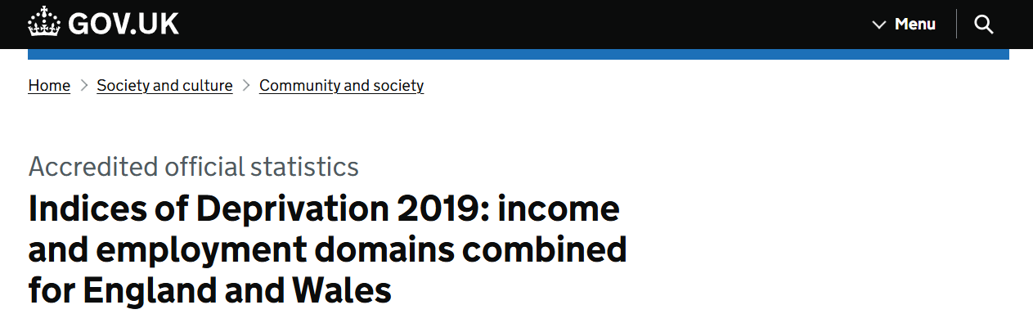
Data Sources – Other Variables
The "Indices of Deprivation 2019" are a measure of relative deprivation across England and Wales. The income and employment domains are combined to highlight areas with high levels of economic hardship, helping to identify regions where people may experience greater social and financial challenges.
Notes:
House price
Ethnic makeup

Slide 10

Methodology
Descriptive spatial analysis:
Mapping S&S rates across LSOAs to visualise clustering
Visualise other variables to see if patterns emerge
Regression models:
Regression with Fixed Effects on Borough
Regression with Interaction terms
Compare coefficients for London and Merseyside separately

Slide 11
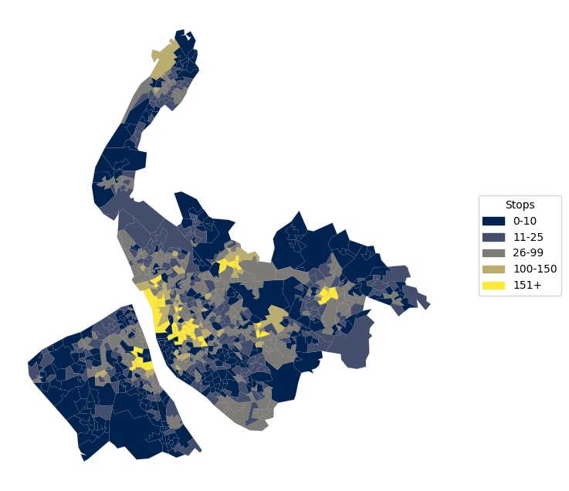
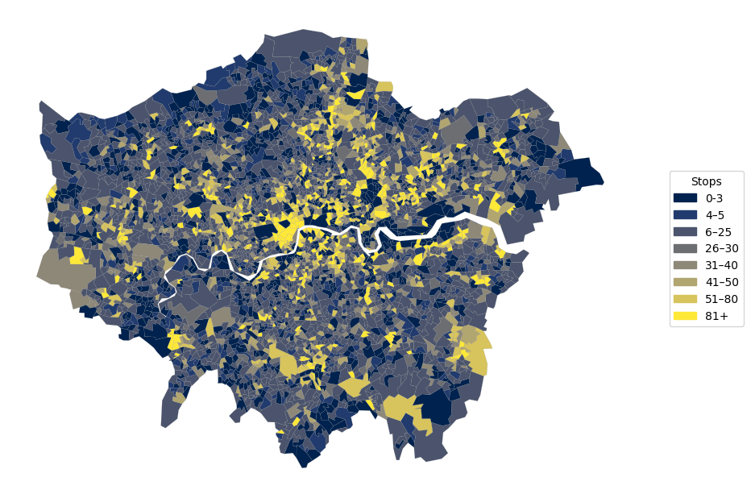
Preliminary Analysis – Stop & Search

Slide 12
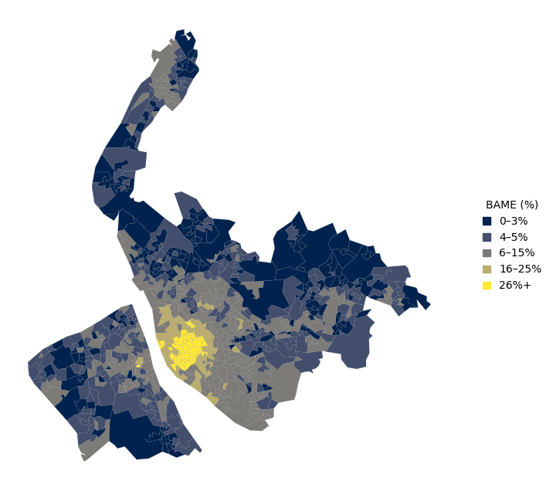
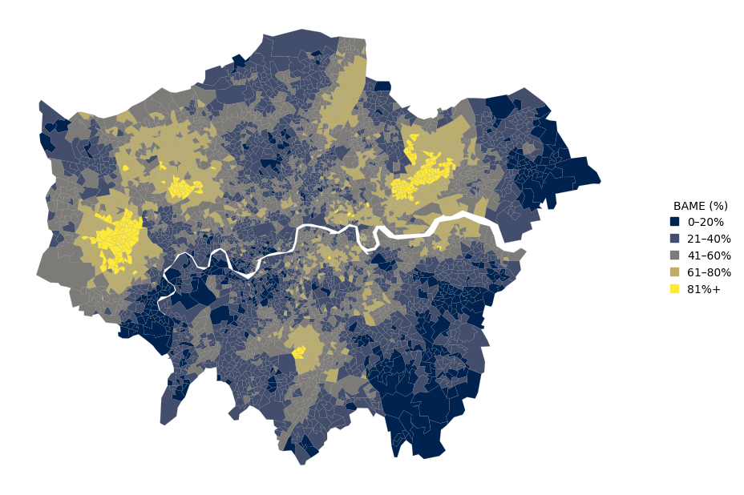
Preliminary Analysis – BAME %

Slide 13
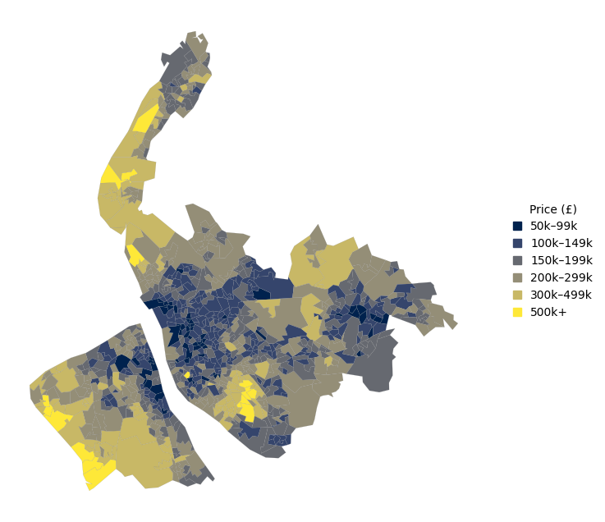
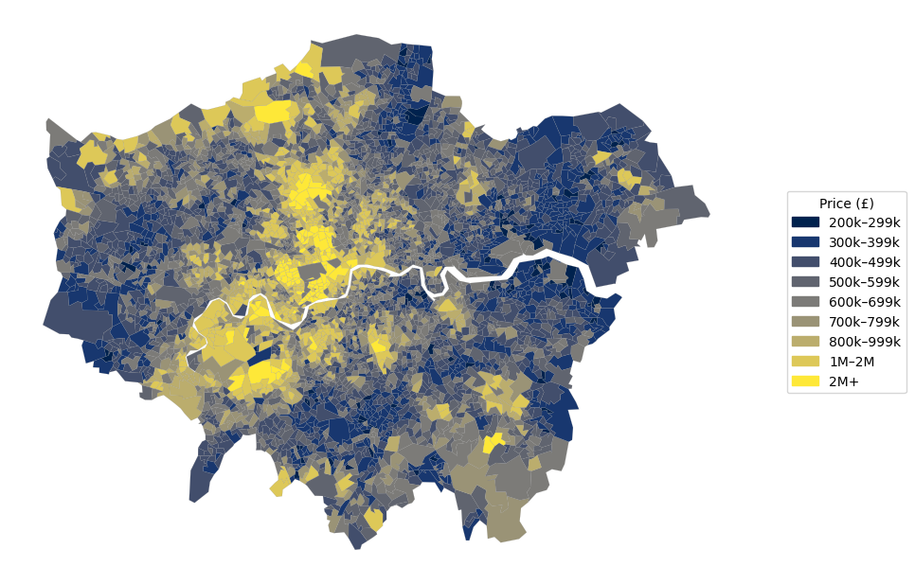
Preliminary Analysis – House Price

Slide 14
Next Steps
Cleaning the data
1
Run full regression models with controls
2
Conduct robustness checks
3
Interpret comparative results and begin writing
4
Notes:
Check lm vs poisson vs nb -- check overdispersion

Slide 15
Thank you for listening..

